Slide 1
USE CASE for Agile

Slide 2
Use Case Name: Place Order
Actors:
Shopper
Fulfillment System
Billing System
Use Case Description:
After the user has selected items to purchase and then order the items, the user will provide payment and shipping information. The system will respond with confirmation of the order and a tracking number that the user can use to check on order status in the future. The system will also provide the user with an estimated delivery date for the order, which will include all selected items. The user may already have an account with the company with billing and shipping information.

Slide 3
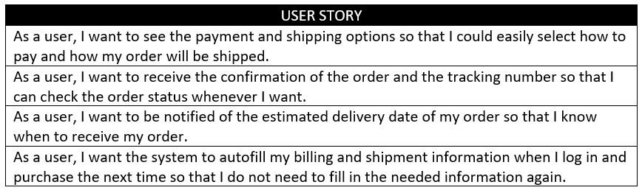
Product Backlog Creation
Notes:
Product backlog is a list that consists of features that should be implemented during the development process. It’s ordered by priority and its every item is called a User story.

Slide 4
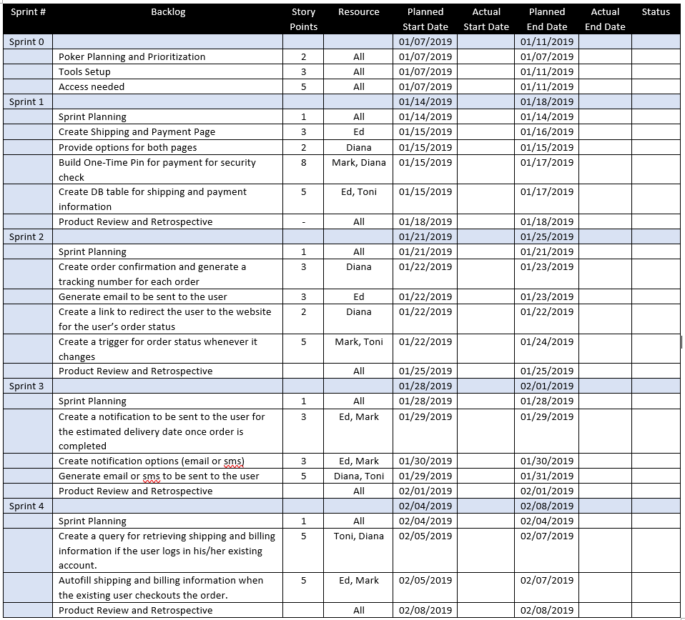
Sprint Planning and Sprint Backlog Creation
Notes:
Firstly, you should determine what your sprint’s duration will be. A short sprint allows you to release the working version of a product more frequently.
After that, the scrum team can select the most important user stories from the product backlog. Then team members should decide how they will solve this or that task.
The Sprint backlog should be created next. It consists of user stories that will be completed during the current sprint. The amount of these stories depends on their duration in story points assigned to each story during evaluation stage. The team should be capable to finish all these stories on time.

Slide 5
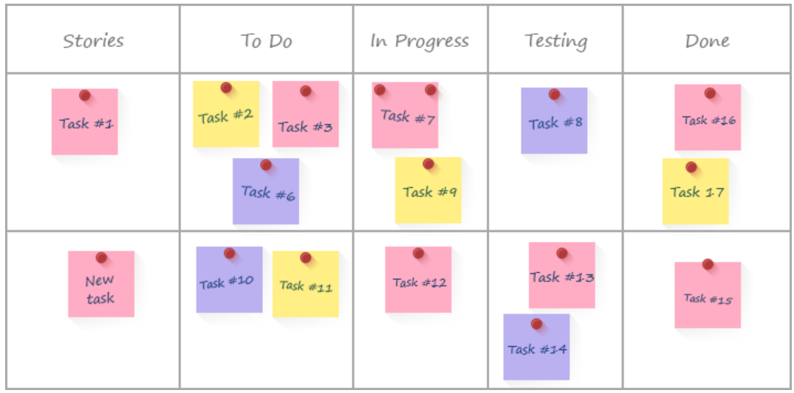
Working on the sprint and scrum meetings
Notes:
After actual user stories for the current phase are chosen, the website development process begins.
To track the current working process, a task board is commonly used.
There are cards with the names of the user stories which are arranged according to their importance. When work on a task has been started, the corresponding sticker is moved from the “To do” field to the “In progress” one. When work is completed, the sticker can be moved to the “Testing” field and after the task is successfully tested, the sticker goes to the “Done” field.
Other important scrum feature is everyday Scrum meetings.
These meetings’ main goal is to get full and veracious information about the current project status. During these meetings every single team member should tell about the task that he has finished, which task he will choose next and what problems he faced during his work.

Slide 6
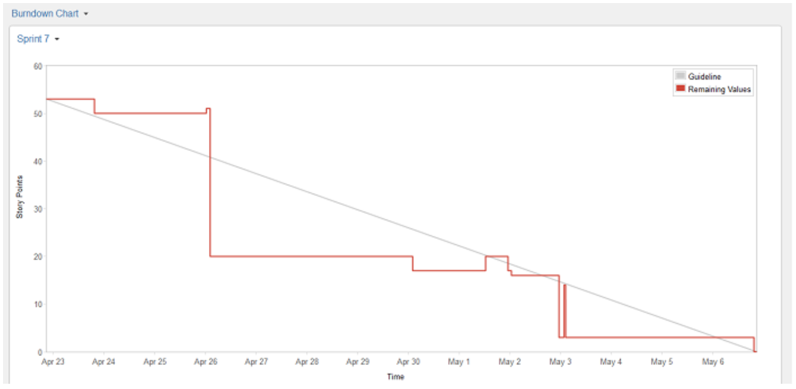
Burndown chart
Notes:
Next is the burn down chart. It is what the scrum team gets as a result of scrum meeting. It shows you how many tasks remains uncompleted. This chart gives an ability to control the development process and should be updated after every meeting.
The X-axis represents the remaining days of work, while the Y-axis displays the overall amount of story points for the current stage. After a task that required a certain number of story points to complete is over, you can add a point on the diagram to indicate the current progress.
One software used in creating burndown charts is JIRA.
This chart helps draw conclusions about the current speed of work. Depending on these conclusions, the amount of user stories for the next sprint can be changed.
Day by day meetings help increase flexibility of the development process. They also allow understanding what changes should be made.

Slide 7
Testing and Product demonstration
Notes:
Since the ideal result of every sprint is a working product, the full life-cycle testing process is very important. There are different ways to minimize costs of the testing period. For example, you can decrease the overall amount of user stories. As a result, the number of possible bugs will be minimized. The other way is to include QA engineers into the scrum team.
The result of every sprint is product demonstration. The Scrum team creates a review and demonstrates the results of their work. On this basis the stakeholders take a decision about further project changes.

Slide 8
Retrospective and next sprint planning
Notes:
Retrospective’s main aim is to discuss the results and determine the ways how to improve development process on the next step. The team should conclude what went well during the working process and what can be done better during the future iteration. When the ways of improvement are defined, the team can concentrate on the next sprint planning.

